Slide 1
Studies on Reversible Logic Based Gates and Circuits for Arithmetic Operations
Presentation for Synopsis Submission
A.Kamaraj
[Reg. No. 1414489180]
Ph.D. Scholar (Part-time), Anna University, Chennai.
Working in: Department of ECE,
Mepco Schlenk Engineering College, Sivakasi
Supervisor
Dr.P.Marichamy,
Department of ECE,
P.S.R. Engineering College, Sivakasi

Slide 2
Contents of the Presentation
Introduction to Reversible Logic
Scope of the Research
Objectives of the Research
Literature Survey (RL Gates, ALU, Division and Multiplier)
Reversible KMD Gates, Adder and Multiplier
Design of Arithmetic and Logic Unit (ALU)
Design of Floating Point Division Unit
Design of Vedic Multiplier
Contributions of the Research
Conclusion
References
Publications

Slide 3
Introduction to Reversible Logic
Amount of energy dissipation is KTln2 per bit erase.
Reversible Logic - equal number of inputs and outputs.
Basic Reversible Gates – Feynman, Fredkin, Taffoli
Performance Metrics – Quantum Cost, Garbage Outputs, Constant Inputs
Ex.: A, B – Inputs; C=0 (Constant Input); R=A.B (Output); P,Q=Garbage Output
TOFFOLI GATE
A
P=A
B
Q=B
C=0
R=AB⊕C

Slide 4
Properties of Reversible Gate
Reversibility
- Unique Mapping)
Universality
- Produce AND/NAND, OR/NOR, NOT)
Parity Preservation
I₁⊕ I₂⊕ I₃⊕ ... ⊕ I_{i} = O₁⊕ O₂⊕ O₃⊕ …⊕ O_{i}

Slide 5
Objectives of the Research
To analyse the reversible logic gates and circuits which are reported in the literature qualitatively and make comparison among them.
To propose new reversible logic gates providing higher number of functionalities with parity preservation and useful to enhance the performance.
To design the reversible logic based digital circuits especially for arithmetic operations to provide enhanced performance with parity preservation capability in comparison with the circuits reported in the literature.

Slide 6
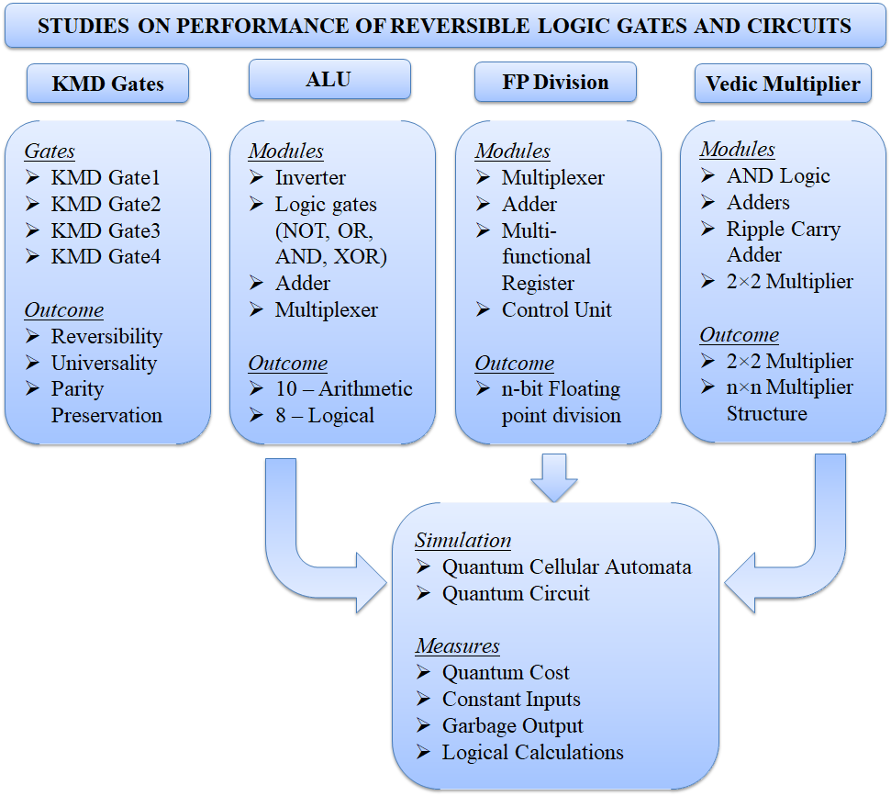
Research Carried Out

Slide 7
Literature Review
S. No. | Author | Year | Name of the Gate | Size of the Gate | Quantum Cost | Application | Remark
1. | Prashanth, N.G et. al. | 2013 | MIG | 6×6 | 7 | Full Adder/ Subtractor | Higher Size
2. | Vasudevan DP et al. | 2006 | R gate | 3×3 | 6 | basic logical functions | R, U – Yes; PP – No
3. | Thapliyal H et. al. | 2009 | TR gate | 3×3 | 7 | Full Adder/ Subtractor | R, U – Yes; PP – No
4. | Mahammad S K N et. al. | 2010 | URG | 3×3 | 10 | Logical Functions & FFs | R, U – Yes; PP – No
5. | Roohi A et. al. | 2016 | PPRG | 3×3 | 19 | Full Adder | R, PP – Yes; U – No
6. | Thapliyal H et. al. | 2005 | TSG | 4×4 | 33 | Adder (BCD, CLA etc…) | R, U – Yes; PP – No
7. | Morrison et. al. | 2011 | MRG | 4×4 | 6 | ALU Design | 6 Operations only
8. | Neeraj Kumar et. al. | 2016 | UPPG | 4×4 | 10 | ALU Design | 14 Operations; R, U, PP - Yes
9. | Ali Newaz et. al. | 2015 | NFT | 4×4 | 9 | QCA Realization | Used Majority voter gates
R- Reversibility; U-Universality; PP-Parity Preservation

Slide 8
Literature Review (ALU)
Author | Year | ALU using the Gates | No. of Operations | No. of Gates | GO | QC | Characteristic
Syamala Y et. al. | 2011 | DPG, YAG | 4 | 7 | 5 | 30 | Only 4 functions
Guan Z et. al. | 2011 | DXOR | 6 | 3 | 3 | 20 | 6 functions and Quantum cost reduced.
Morrison M et. al. | 2011 | HNG, PAOG, MRG | 8 | 6 | 4 | 28 | Increased number of functions. Requirement of number of gates higher. Quantum cost increases.
Morrison M et. al. | 2012 | HNG, MG, UPG | 9 | 8 | 5 | 35
Bibhash et. al. | 2014 | RM | 16 | 14 | 15 | 320 | Perform 16 different functions. Requirement of number of gates higher. Both Garbage output and Quantum cost increases.
Trailokya et. al. | 2016 | RUG | 16 | 14 | 11 | 197

Slide 9
Contd…
Author | Year | Type and No. of Functions | Basic Gate | Special Gate | Parity | QC | Remarks
Saligram R et. al. | 2013 | 8 (Arith.) + 4 (Logic) | F2G, Toffoli | IG, PPPG | Yes | 108 | Adder is included as separate unit
Kaur T et. al. | 2013 | 8 (Arith.)+ 7 (Logic) | Fredkin | FTRA | Yes | 41 | Cost is increased when FTRA is included
Mukhopadhyay M et. al. | 2013 | 4 (Arith.)+ 7 (Logic) | F2G, Peres, Toffoli | PPPG | Yes | 75 | Mux based Boolean function generator
Bibhash S et. al. | 2014 | 7 (Arith.) + 9 (Logic) | Feynman, Peres | RM | Yes | 320 | Mux is used for combining Logical and Arithmetic unit
Lenin G et. al. | 2014 | 7 (Arith.)+ 4 (Logic) | - | PFAG, HNG | No | 67 | Control Unit for ALU is introduced.
Chaves F et. al. | 2015 | 8 Logical | Feynman, Toffoli | - | No | - | No Arithmetic operations
Trailokya N et. al. | 2016 | 7 (Arith.) + 9 (Logic) | Toffoli | RUG | Yes | 197 | Mux is used for combining Logical and Arithmetic unit
Armin N et. al. | 2017 | 4 (Arith.) + 7 (Logic) | Feynman, Fredkin | NHG | Yes | 19 | Integrated ALU Structure
Vandana S et. al. | 2018 | 8 - Arith. | Feynmann | DKG | No | - | No logical operations
Abdul B et. al. | 2019 | 4 (Arith.)+ 6 (Logic) | Feynman, Fredkin | HNG, PAOG, MRG | No | - | No Novelty, Architecture is Same as Bibhash S et. al.

Slide 10
Literature Review (Division)
Author | Year | Major Contribution | Basic Gate | Special Gate | Parity | Remarks
Faraz D et. al. | 2011 | FP Division (PIPO reg.) | F2G, Fredkin | - | Yes | FP Mux, Adder, n-bit
Faraz D et. al. | 2012 | Signed Division | F2G, Fredkin | - | No | n-bit, OVF Detection
Jamal L et. al. | 2013 | FP Divider | Feynman | DPG | No | 16 bit division (Array)
AnanthaLakshmi AV et. al. | 2015 | Restoring and Non-Restoring Division | Majority Voter | - | No | Array, Fixed point
Sayedsalehi S et. al. | 2015 | FP Adder, Multiplication, Division | Feynman, Fredkin | - | No | Only Architecture
Hafiz M et. al. | 2016 | FP Division | F2G, Fredkin | RR | Yes | n-bit
Ali B et. al. | 2016 | Non-Restoring Division | F2G, Fredkin | BHA, BHB, BBHC, BHD | No | n-bit
Mohammad M et. al. | 2017 | CAS, Non-Restoring Division (6×6) | Majority Voter | - | No | Array, Fixed point
Anantha Lakshmi AV et. al. | 2017 | FP Arithmetic | Feynman, Fredkin | TR | No | Add/sub, Multiplication, Division, Square root

Slide 11
Literature Review (Multiplier)
Author | Year | Major Contribution | Basic Gate | Special Gate | PP | QCkt | Remarks
Poornima M et. al. | 2013 | 8×8 Vedic | - | - | - | - | Not Reversible
Siba Kumar P et. al. | 2015 | 8×8 Vedic | - | - | - | - | Not Reversible
Rakshith TR et. al. | 2013 | 4×4 Vedic | Peres, Feynman | HNG | No | No | First Reversible
Rakshith S et. al. | 2013 | 4×4 Vedic | Peres , Feynman | NFT, BVPPG | No | No | Cost reduction than [55]
Shifana AP et. al. | 2014 | Array Vs Vedic | Peres, Feynman | HNG | No | No | Vedic Performs Better
Srikanth G et. al. | 2014 | 32×32 Vedic, Array Vs Vedic | Peres, Feynman | HNG | No | No | Vedic Performs Better
Gowthami P et. al. | 2018 | 16×16 Vedic | Peres , Feynman | HNG, BME | No | No | -
Ashvin C et. al. | 2018 | N×N | Majority Voter [86] | - | No | No | Better than High speed Multipliers

Slide 12
3×3 Reversible Gates
Peres
R Gate
TR Gate
URG Gate
PPRG Gate
SAM Gate
RM Gate and
RUG Gate

Slide 13
Peres Gate
R Gate
A
P=A
A
P=A⊕B
B
Q=A⊕B
B
Q=A
C
R=AB⊕C
C
R=AB⊕C’
TR Gate
URG Gate
A
P=A
A
P=AB⊕C
B
Q=A⊕B
B
Q=B
C
R=AB’⊕C
C
R=(A+B)⊕C
PPRG Gate
SAM Gate
A
P=A⊕B
A
P=A’
B
Q=AC+B’C’
B
Q=A’B⊕AC’
C
R=A’C+B’C’
C
R=A’C⊕AB

Slide 14
4 × 4 Reversible Gates
TSG Gate
HNG Gate
MRG Gate
UPPG Gate
PAOG Gate
SMS Gate
OTG Gate

Slide 15
A
R1 Gate
P=A⊕C
A
TSG Gate
P=A
B
Q=B⊕C⊕AB⊕BC
B
Q=A’B’⊕B’
C
R=A⊕B⊕C
C
R=(A’C’⊕B’)⊕D
D
S=AB⊕BC⊕C⊕D
D
S=(A’C’⊕B’)D⊕(AB⊕C)
A
OTG Gate
P=A
A
PAOG Gate
P=A
B
Q=A⊕B
B
Q=A⊕B
C
R=A⊕B⊕D
C
R=AB⊕C
D
S=(A⊕B)D⊕(AB⊕C)
D
S=((A⊕B)⊕D)⊕(AB⊕C)
A
SMS Gate
P=A⊕C⊕D
A
BME Gate
P=A
B
Q=D⊕BC
B
Q=AB⊕C
C
R=C
C
R=AD⊕C
D
S=BC⊕C⊕B⊕D
D
S=A’B⊕C⊕D

Slide 16
Objectives of the Proposed New Reversible Gates
Maintain the uniformity of the design
(designing the reversible circuits with the same
type of gates).
Implement the reversible circuits with the new gates providing improved performance
(with less cost in terms of Quantum Cost, Garbage
Output and Logical Calculations).

Slide 17
PROPOSED NEW REVERSIBLE GATES
KMD Gate1
KMD Gate2
A
P=A
A
P=A
B
Q=A’C⊕AB’
B
Q=A’B’⊕AC
C
R=A’B⊕AC’
C
R=A’C’⊕AB
A
KMD Gate3
P=A⊕D
B
Q=B⊕C⊕D
C
R=A’C⊕AB
D
S=A’C⊕AB⊕D
A
KMD Gate4
P=A
B
Q=A’B⊕AC’
C
R=A⊕B⊕C
D
S=A(B⊕ C)⊕BC⊕D
E
T=BC’⊕E

Slide 18
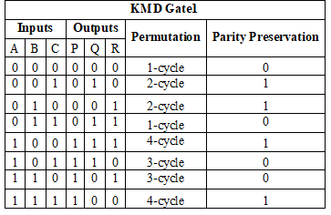
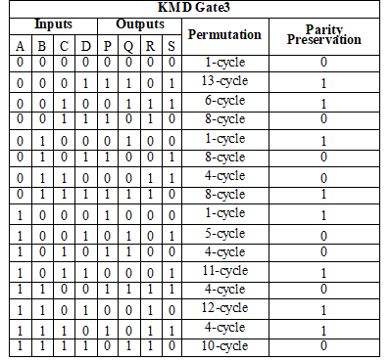
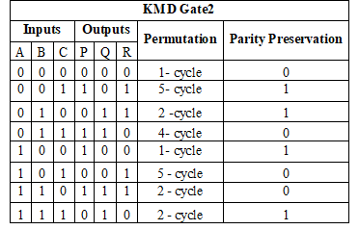
Truth Table (Reversibility and Parity Preservation)

Slide 19
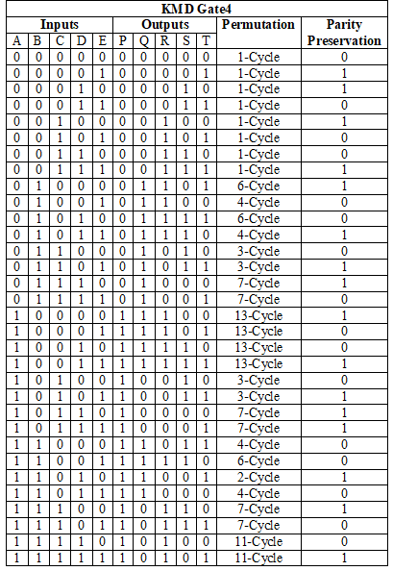
Contd…

Slide 20
Universality Property of KMD Gates
S. No. | Reversible Gate | Constant Input | Logic Function | Expression
1. | KMD gate1 | A=1; C=0 / 1 | Q=NOT (B) | Q = R’
 |  | C=1 | Q = NAND (A,B) | Q = A’ + AB’
 |  | C=0 | R = OR (A, B) | Q = A + A’B
2. | KMD gate2 | B=C=0 | R = NOT (A) | R = A’
 |  | C=0 | Q = NOR (A,B) | Q = A’B’ = (A+B)’
 |  | C=1 | R = AND (A,B) | R = AB
3. | KMD gate3 | B=D=0; C=1 | S = NOT (A) | S = A’
 |  | B=1 | R = OR (A, C) | R = A + A’C
 |  | C=0 | R = AND (A, B) | R = AB
4. | KMD gate4 | B=C=1;D=0 | Q = NOT(A) | Q = A’
 |  | B=1 | Q = NAND (A,C) | Q = A’ + AC’
 |  | B=1; D=0 C=0 | T = OR (A,C) Q = OR(A,C) | T = AC’ + C Q = AC’ + C

Slide 21
Comparison of the Proposed KMD Reversible Gates with the Existing
KMD Gates (3×3)
Characteristics | TR | PPRG | TSG | DKG | KMD Gate1
Functions | NOT, XOR, XNOR | NOT, AND, XOR | NOT, XOR, XNOR | NOT, XOR, AND | NOT, OR, NAND
Cell Count | 113 | 171 | - | 752 | 169
KMD Gates (4×4)
Characteristics | Peres | NFT | RM | RUG | KMD Gate2 | KMD Gate3
Functions | NOT, AND, NAND, XOR | XOR, AND, NOT, OR | NOT, XOR, AND, OR | AND, XOR, OR, NOT | AND, OR, NOT, NOR | XOR, AND, NOT, OR
Cell Count | 273 | 128 | 178 | 196 | 121 | 116
KMD gates (5×5)
Characteristics | R Gate | R1 | OTG | SMS | KMD gate4
Functions | NOT, AND, OR, NAND, XOR | NOT, OR, NAND, XOR, XNOR | NOT, NAND, XOR, XNOR, Majority | NOT, AND, NAND, XOR, XNOR | XOR, AND, OR, NOT, NAND
Cell Count | 105 | - | - |  | 244

Slide 22
Characteristics and Performance of KMD Gates
S. No. | Name of the Reversible Gate | Reversibility | Universality | Parity Preservation | Gate Count | Quantum Cost | Number of Functions (NoF) | Logical Calculations
1. | KMD gate1 | Yes | Yes | Yes | 5 | 10 | 3 | 2α+4β+3γ
2. | KMD gate2 | Yes | Yes | Yes | 6 | 10 | 4 | 2α+4β+3γ
3. | KMD gate3 | Yes | Yes | Yes | 5 | 9 | 4 | 5α+3β+1γ
4. | KMD gate4 | Yes | Yes | Yes | 8 | 12 | 5 | 6α+4β+2γ

Slide 23
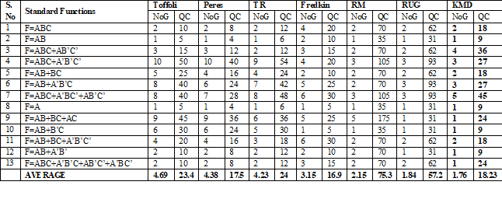
Performance of KMD Gates

Slide 24
Realization of 13 Standard Functions
S. No | Standard Functions | Toffoli |  | Peres |  | TR |  | Fredkin |  | RM |  | RUG |  | KMD
 |  | NoG | QC | NoG | QC | NoG | QC | NoG | QC | NoG | QC | NoG | QC | NoG | QC
1 | F=ABC | 2 | 10 | 2 | 8 | 2 | 12 | 4 | 20 | 2 | 70 | 2 | 62 | 2 | 18
2 | F=AB | 1 | 5 | 1 | 4 | 1 | 6 | 2 | 10 | 1 | 35 | 1 | 31 | 1 | 9
3 | F=ABC+AB’C’ | 3 | 15 | 3 | 12 | 2 | 12 | 3 | 15 | 2 | 70 | 2 | 62 | 4 | 36
4 | F=ABC+A’B’C’ | 10 | 50 | 10 | 40 | 9 | 54 | 4 | 20 | 3 | 105 | 3 | 93 | 3 | 27
5 | F=AB+BC | 5 | 25 | 4 | 16 | 4 | 24 | 2 | 10 | 2 | 70 | 2 | 62 | 2 | 18
6 | F=AB+A’B’C | 8 | 40 | 6 | 24 | 7 | 42 | 5 | 25 | 2 | 70 | 3 | 93 | 3 | 27
7 | F=ABC+A’BC’+AB’C’ | 8 | 40 | 7 | 28 | 8 | 48 | 6 | 30 | 3 | 105 | 3 | 93 | 5 | 45
8 | F=A | 1 | 5 | 1 | 4 | 1 | 6 | 1 | 5 | 1 | 35 | 1 | 31 | 1 | 9
9 | F=AB+BC+AC | 9 | 45 | 9 | 36 | 6 | 36 | 5 | 25 | 5 | 175 | 1 | 31 | 1 | 24
10 | F=AB+B’C | 6 | 30 | 6 | 24 | 5 | 30 | 1 | 5 | 1 | 35 | 1 | 31 | 1 | 9
11 | F=AB+BC+A’B’C’ | 4 | 20 | 4 | 16 | 3 | 18 | 6 | 30 | 2 | 70 | 2 | 62 | 2 | 18
12 | F=AB+A’B’ | 2 | 10 | 2 | 8 | 2 | 12 | 2 | 10 | 2 | 70 | 1 | 31 | 1 | 9
13 | F=ABC+A’B’C+AB’C’+A’BC’ | 2 | 10 | 2 | 8 | 2 | 12 | 3 | 15 | 2 | 70 | 2 | 62 | 1 | 24
 | AVERAGE | 4.69 | 23.4 | 4.38 | 17.5 | 4.23 | 24 | 3.15 | 16.9 | 2.15 | 75.3 | 1.84 | 57.2 | 1.76 | 18.23

Slide 25
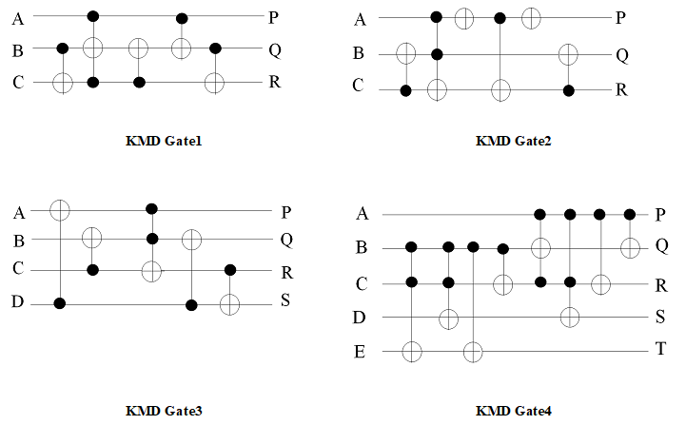
Quantum Circuit of KMD Gates

Slide 26
Derivative functions of KMD gates
Inverter function obtained from KMD gate1 for the inputs A & B.
2×1 multiplexer & XOR gate is derived from KMD Gate 3
AND logic is derived using KMD gate2
OR logic is derived from KMD gate1
XOR logic from KMD gate3
Adder function from KMD gate4
D latch function from KMD gate3
Multi-functional register is derived from D-latch

Slide 27
KMD Gate1 (Inverter)
KMD Gate2 (AND)
A
P=G
A
P=G
B=1
Q=A’
B
Q=G
C=1
R=A’
C=1
R=AB
KMD Gate1 (OR)
A
KMD Gate3 (XOR)
P=A⊕B
A
P=G
0
Q=G
B
Q=G
0
R=G
C=0
R=A’B⊕A
B
S=G
Sel
KMD Gate3 (Mux)
P=G
A
Q=G
B
R=Sel’B⊕SelA
0
S=G

Slide 28
A
KMD Gate4 (Adder)
P=G
A
KMD Gate3 (Half Adder)
P=A⊕B
B
Q=G
B
Q=G
C
R=A⊕B⊕C
0
R=AB
0
S=A(B⊕ C)⊕BC
B
S=G
0
T=G
CLK
KMD Gate3
(D LATCH)
P=CLK
D
Q=G
R=CLK’.Q⊕CLK.D
0
S=Q

Slide 29
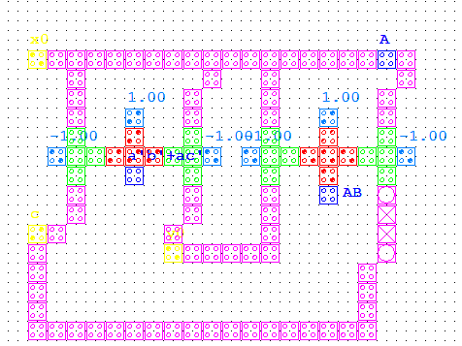
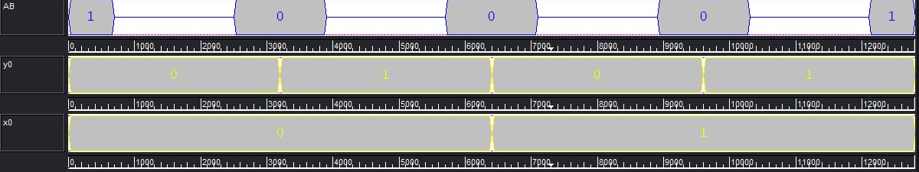
REALIZATION OF LOGIC GATES
Inverter
AND Logic

Slide 30
Contd…
OR Logic
XOR Logic

Slide 31
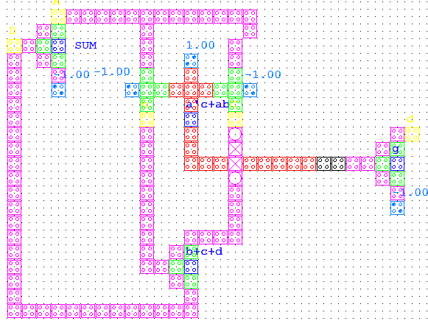
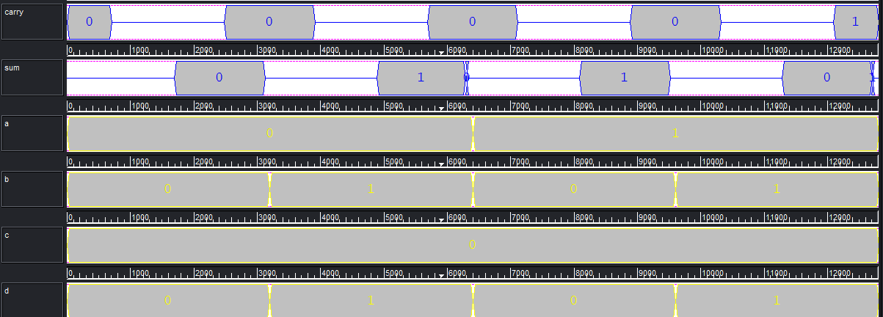
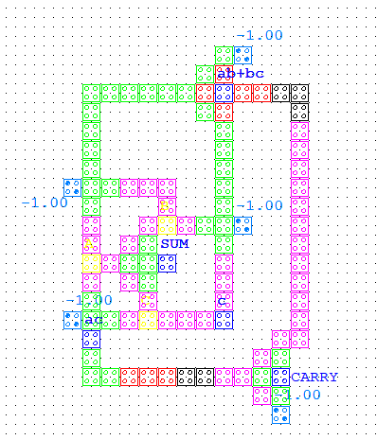
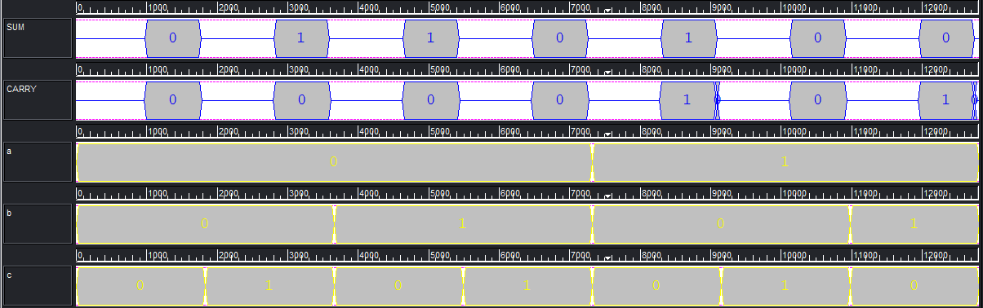
Contd…
Half Adder
Full Adder

Slide 32
Contd…
Multiplexer

Slide 33
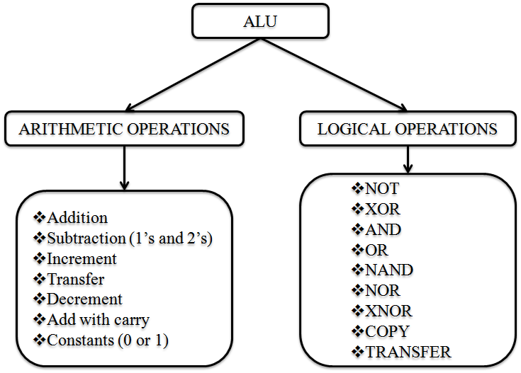
design of arithmetic logic unit (ALU)

Slide 34
Objectives of ALU Design
Design an ALU with the following Features:
having integrated functional module for performing both Arithmetic and Logical operations.
parity preservation property for fault detection.

Slide 35
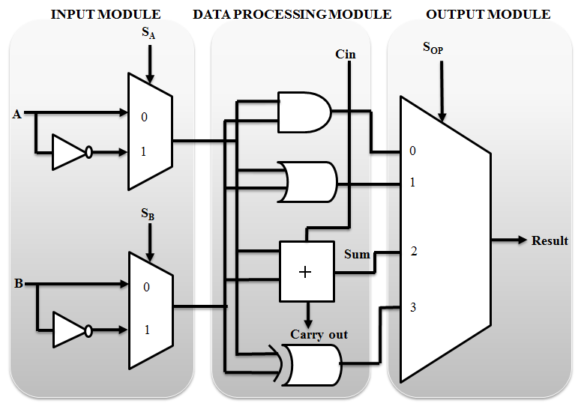
PROPOSED REVERSIBLE ARITHMETIC AND LOGIC UNIT (ALU) ARCHITECTURE

Slide 36
Design Approaches
Approach 1:
All the functional modules (Input, Data processing & Output) are constructed only with KMD gates.
Approach 2:
The functional modules are constructed using the combination of KMD gates, Fredkin and Toffoli gates.

Slide 37
Reversible Arithmetic Operations
Inputs | Constant Inputs | S_{A} | S_{B} | S_{OP} |  | Result | Type of Operation
A=A | B=1 | 0 | 0 | 0 | 0 | A | TRANSFER A
B=B | A=1 | 0 | 0 | 0 | 1 | B | TRANSFER B
A=A; B=B; Cin=Cin | - | 0 | 0 | 1 | 0 | Sum = A⊕B⊕Cin Carry out = AB + BCin + ACin | FULL ADDER
A=A; B=B; Cin=Cin | Cin = 1 |  |  |  |  | Sum = A⊕B⊕1 | ADD WITH CONSTANT CARRY
B=B | A=0 | 0 | 1 | 0 | 1 | B+1 | INCREMENT B
A=A; Cin=B | B=B | 0 | 1 | 1 | 0 | A+B | Add
A=A; B=B | - | 0 | 1 | 1 | 1 | A⊕B’ | 1’s Complement Addition
A=A | B=0 | 1 | 0 | 0 | 1 | A’ | INCREMENT A
A=A; B=B | Cin = 0 | 1 | 0 | 1 | 0 | Sum = A⊕B Carry out = AB | HALF ADDER
B=B | A=1 | 1 | 1 | 0 | 1 | B’ | DECREMENT B
B=B; Cin=Cin | A=0 | 1 | 1 | 1 | 0 | B’⊕Cin | 2’s Complement Addition
A=A | B=1 | 1 | 1 | 1 | 1 | A’ | DECREMENT A

Slide 38
Reversible Logical Operations
Inputs | Constant Inputs | S_{A} | S_{B} | S_{OP} |  | Result | Type of Operation
A=A; B=B | Cin=0 | 0 | 0 | 0 | 0 | AB | AND
 |  | 0 | 0 | 0 | 1 | A | B | OR
A=0; B=0; | Cin=0 | 0 | 0 | 1 | 0 | 1 | CONSTANT 1
A=A; B=B | - | 0 | 0 | 1 | 1 | A⊕B | XOR
A=A; B=B | - | 0 | 1 | 1 | 1 | (A⊕B)’ | XNOR
B=B | A=1 | 1 | 0 | 0 | 0 | 0 | CONSTANT 0
B=B | A=1 | 1 | 0 | 1 | 1 | B | COPY B
A=A; B=B | Cin=0 | 1 | 1 | 0 | 0 | A’B’= (A|B)’ | NOR
A=A; B=B | Cin=0 | 1 | 1 | 0 | 1 | A’|B’ = (AB)’ | NAND
A=A | B=0 | 1 | 1 | 1 | 1 | A | COPY A

Slide 39
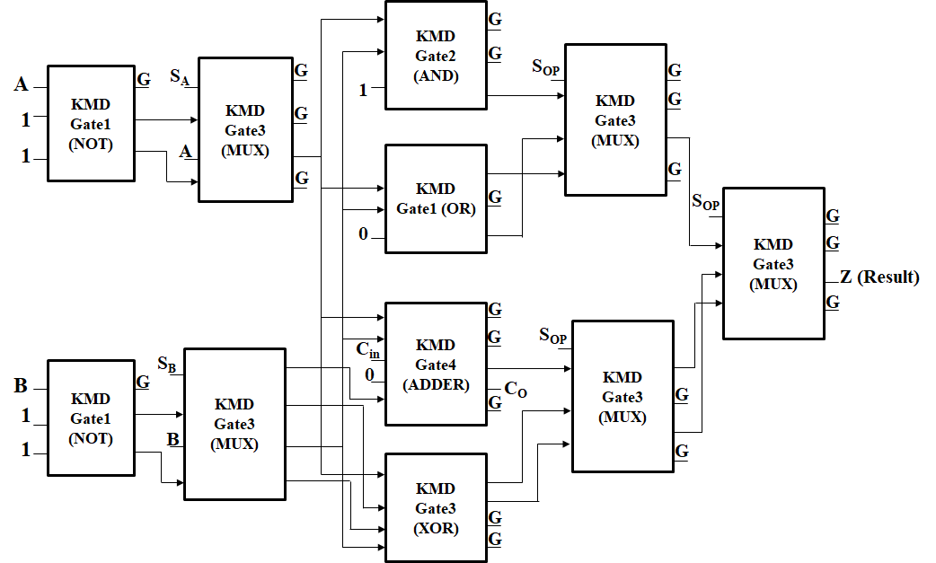
Design Approach-1

Slide 40
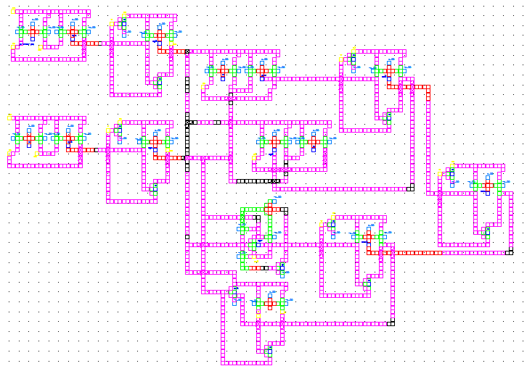
QCA Realization of the Proposed ALU Architecture

Slide 41
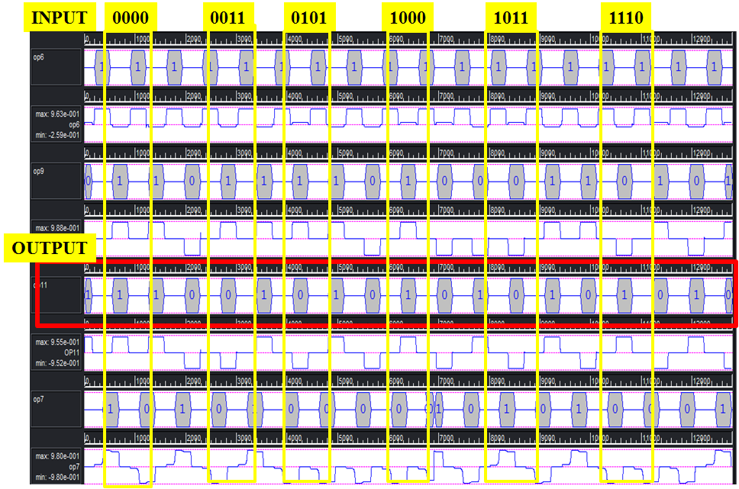
QCA Simulation

Slide 42
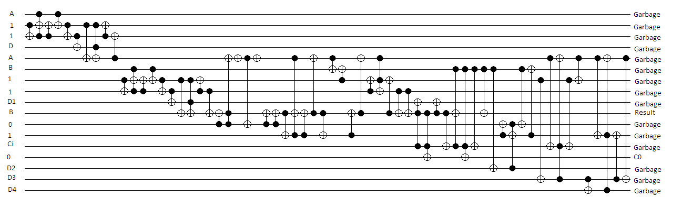
Quantum Circuit of the Proposed ALU Architecture

Slide 43
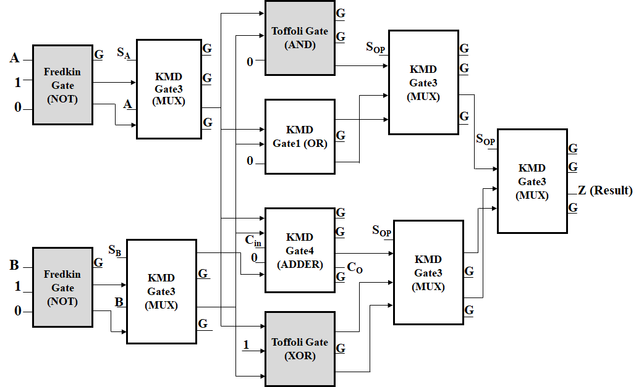
Design Approach-2

Slide 44
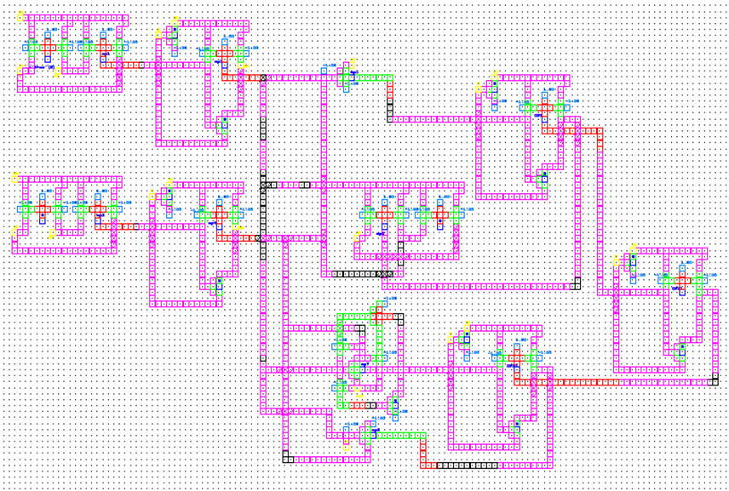
QCA Realization

Slide 45
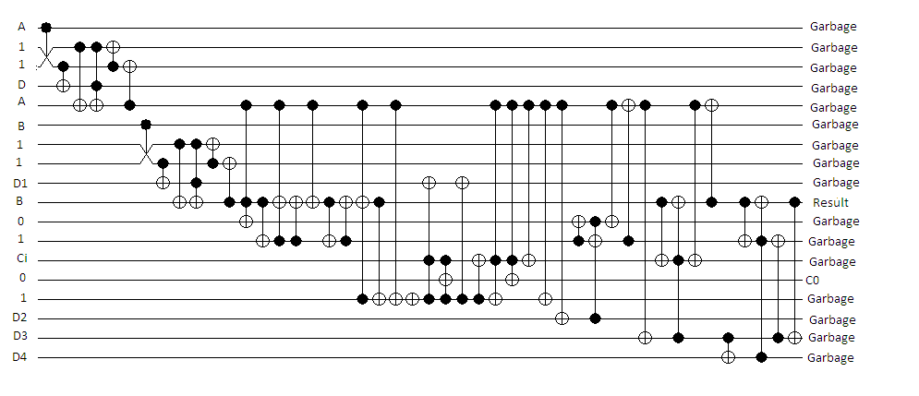
Quantum Circuit of the Proposed ALU Architecture

Slide 46
Number of Operations of Reversible ALU
Type of Operation | Number of Operations of ALU constructed using the Gates of
 | FTRA [191] | PPPG [137] | NHG [198] | UPPG [31] | RM [35] | RUG [36] | KMD Gates Only (Approach-1) | Combination of KMD, Fredkin & Toffoli (Approach-2)
Arithmetic Operation | 8 | 4 | 4 | 8 | 7 | 7 | 10 | 10
Logical Operation | 7 | 7 | 7 | 8 | 9 | 9 | 8 | 8
Total | 15 | 11 | 11 | 16 | 16 | 16 | 18 | 18
% of improvement | - | - | - | - | - | - | 20% to 12.5% | 20% to 12.5%

Slide 47
Performance of ALU
Performance Metrics | ALU using |  |  |  |  |  | Proposed ALU Architecture
 | RM Gate [35] |  |  | RUG Gate [36] |  |  | Approach-1 (KMD Gates) | Approach-2 (KMD, Fredkin and Toffoli Gates)
 | Arithmetic Unit | Logical Unit | Total | Arithmetic Unit | Logical Unit | Total
Quantum Cost | 140 | 140 | 320 | 67 | 94 | 197 | 118 | 99
Constant Inputs | 2 | 2 | 10 | 0 | 1 | 6 | 7 | 8
Garbage Outputs | 6 | 7 | 15 | 3 | 6 | 11 | 21 | 22
No. of Gates Used | 4 | 4 | 14 | 3 | 4 | 14 | 11 | 11
Logical Calculations | 2α+8β+3γ | α+9β+4γ | 8α+20β+9γ | 3α+β | α+6β+6γ | 9α+12β+11γ | 12α+14β+6γ | 12α+14β+6γ
Parameter | Improvement w.r.t. RM [35] |  | Improvement w.r.t. RUG [36]
 | Approach-1 | Approach-2 | Approach-1 | Approach-2
Quantum Cost | 63% | 69% | 40% | 49%
Constant Inputs | 30% | 20% | No | No
No. of gates used | 21% | 21% | 21% | 21%

Slide 48
design of parity preserving reversible floating point division

Slide 49
Algorithm
Inputs: Dividend (D); Divisor (V) and Select (Sel) = 0.
Outputs: Remainder (R) and Quotient (Q)
Steps:
Set Initially: Clk = High; SP = 0; Sel = 0;
Initialize the Registers: Count = 0; D = 0; V = 0
If (Clk = 1)
If (SP = = 0)
n-bit inputs are loaded parallelly in to operand registers (D & V).
Else if (SP = =1 & Hold = = 0 & Count < n)
The operands are forwarded to n-bit parallel adder (as per non-restoring algorithm 2’s complement addition).
The output of the previous step is loaded into D register and serial left shift one position in PIPO shift register.
If the partial result is positive (i.e. MSB = 0), set Q₀ = 1; otherwise set Q₀ = 0;
Count = Count + 1;
If (Count >= n)
If the result is negative; restore D and do rounding and normalization.
Dividend register MSB = Remainder; LSB = Quotient.
End.

Slide 50
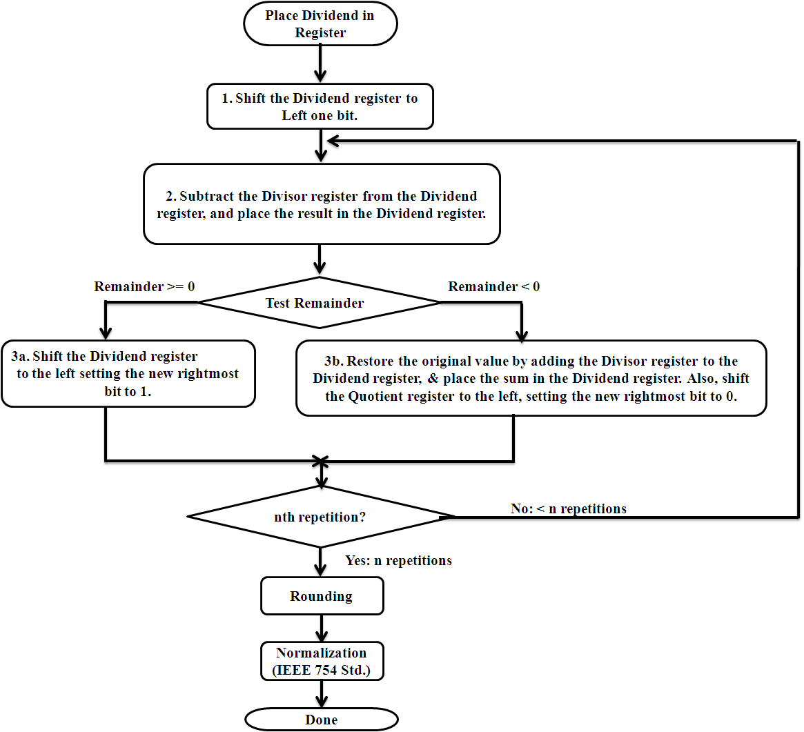
Flow Diagram of Floating Point Division

Slide 51
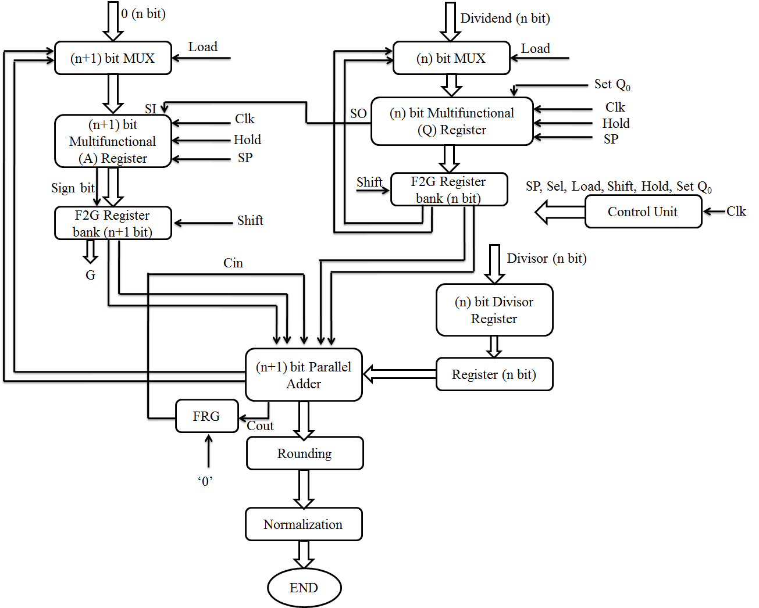
Architecture of Floating Point Division Unit

Slide 52
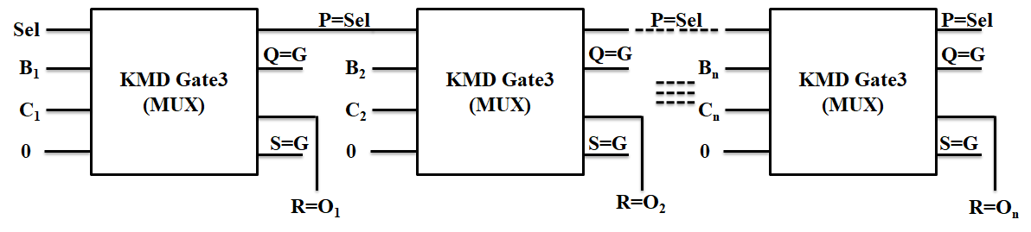
Key Elements of Division Unit
Multiplexer
Input | Outputs
Select Line (A = Sel) | P = Sel ⊕ D | R = Sel’ C ⊕ Sel B
0 | Sel | C
1 | Sel | B

Slide 53
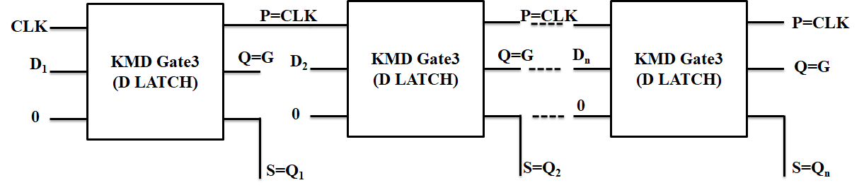
Contd…
Parallel In Parallel Out

Slide 54
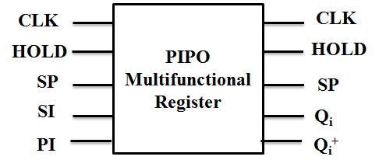
Contd…
Multifunctional Register
Hold | SP | Q_{i}⁺ (Next Output) | Operation
0 | 0 | Ii | Input Loaded to Register in Parallel
0 | 1 | Q_{i-1} | Left Shift & LSB receiving input from Serial Input
1 | X | Q_{i} | Maintaining Previous Value
Q_{i}⁺ = Hold’ SP’ I_{i} + Hold’ SP Q_{i-1} + Hold Q_{i}

Slide 55
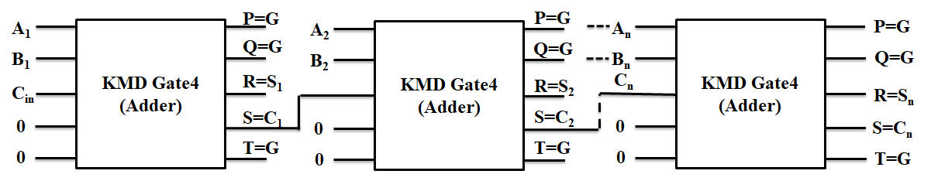
Contd…
Adder

Slide 56
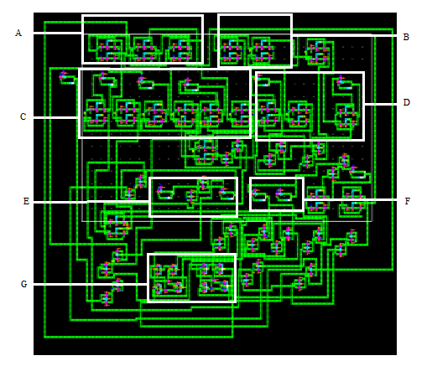
QCA Realization

Slide 57
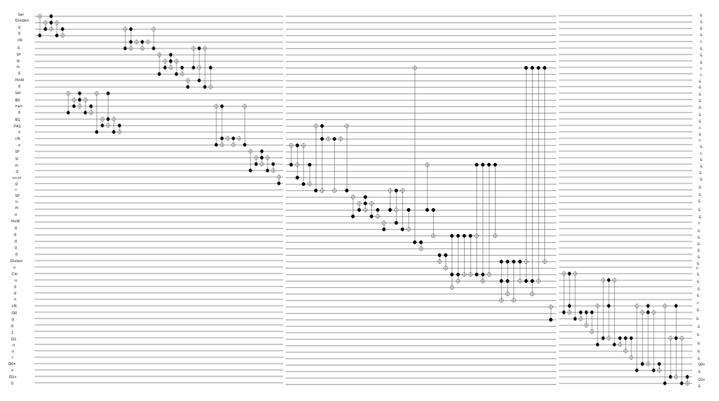
Quantum Circuit

Slide 58
Performance of individual modules of the Division unit
S. No. | Functional Module | Number of Bits | Gates Used | Number of Gates | Quantum Cost | Garbage Output | Constant Input
1. | Multiplexer | n | KMD Gate 3 | n | 6n | 2n | n
 |  | n+1 |  | n+1 | 6n + 6 | 2n+2 | n+1
2. | Multifunctional Register | n |  | 3n | 18n | 5n | 3n
 |  | n+1 |  | 3n+1 | 18n+18 | 5n+5 | 3n+3
3. | Divisor Register | n | F2G | n | 2n | 2n | n
4. | Parallel Adder | n+1 | KMD Gate 4 | n+1 | 12n+12 | 3n+3 | 2n
5. | Register | n | F2G | n | 3n | - | n
 |  | n+1 |  | n+1 | 3n+3 | n+1 | n+1
6. | Other Gates | 1 | Fredkin | 1 | 5 | 2 | 1
7. | Total Cost (of Division Unit) |  |  | 12n+4 | 68n+44 | 20n+13 | 13n+6

Slide 59
Performance comparison of Proposed and existing n-bit Division Unit
Parameters | Existing [50] |  | Existing [51] |  | Proposed
 | Restoring | Non-Restoring | Conventional Division Array | High Speed Division Array
No. of Gates | 18n+23 | 18n+21 | (3(n+2)²+2n)/4 | (n+2)(3n+11)/2 | 12n+4
Garbage outputs | 12n+18 | 12n+16 | (n+2)²/2 | (n+2)(3n+22)/4 | 20n+13
Quantum Cost | 75n+60 | 75n+53 | (4(n+2)²+n)/2 | (n+2)(7n+27)/2 | 68n+44
Constant Input | 11n+14 | 11n+12 | ((n+1)²+1)/2 | (n+2)(3n+14)/4 | 13n+6
Total Cost (QC + GO + CI + NoG) | 116n+115 | 116n+102 | - | - | 113n+67

Slide 60
Comparison of Quantum Cost
Number of Bits | Existing [50] |  | Existing [51] |  | Proposed | Percentage (%) of improvement w.r.t.
 | Res. | Non-R. | Conv. | HS Div. |  | Existing [50] | Existing [51]
2 | 210 | 203 | 33 | 82 | 180 | 11.33 - 14.29 | No
4 | 360 | 353 | 74 | 165 | 316 | 10.48 - 12.22 | No
8 | 660 | 653 | 204 | 415 | 588 | 9.95 - 10.91 | No
16 | 1260 | 1253 | 656 | 1251 | 1132 | 9.66 - 10.16 | 9.51
32 | 2460 | 2453 | 2328 | 4267 | 2220 | 9.5 - 9.76 | 4.64 - 47.94
64 | 4860 | 4853 | 8744 | 15675 | 4396 | 9.42 - 9.55 | 49.73 - 71.96
128 | 9660 | 9653 | 33864 | 59995 | 8748 | 9.38 - 9.44 | 74.17 - 85.42
256 | 19360 | 19253 | 133256 | 234651 | 17452 | 9.35 - 9.86 | 86.9 - 92.56

Slide 61
Comparison of required Number of Gates (NoG)
Number Of Bits | Existing [50] |  | Existing [51] |  | Existing [52] | Proposed | Percentage (%) of improvement w.r.t.
 | Res. | Non-R. | Conv. | HS Div. |  |  | Existing [50] | Existing [51] | Existing [52]
2 | 59 | 57 | 13 | 34 | 44 | 28 | 50.8 -52.5 | 17.65 | 36.36
4 | 95 | 93 | 33 | 69 | 70 | 52 | 44.1 -45.26 | 24.64 | 25.71
8 | 167 | 165 | 79 | 175 | 122 | 100 | 39.4 -40.12 | 42.86 | 18.03
16 | 311 | 309 | 251 | 531 | 226 | 196 | 36.5 -36.9 | 21.9 - 63 | 13.27
32 | 599 | 597 | 883 | 1819 | 434 | 388 | 35 -35.23 | 56 - 78.6 | 10.6
64 | 1172 | 1173 | 3299 | 6699 | 850 | 772 | 34.2 | 76.6 -88.4 | 9.18
128 | 2327 | 2325 | 12739 | 25675 | 1682 | 1540 | 33.8 | 87.9 - 94 | 8.44
256 | 4631 | 4629 | 50051 | 100491 | 3346 | 3076 | 33.5 | 93.8 -96.9 | 8.07

Slide 62
Comparison of Constant Inputs
Number of Bits | Existing [50] |  | Existing [51] |  | Proposed | Percentage (%) of improvement w.r.t.
 | Res. | Non-R. | Conv. | HS Div. |  | Existing [50] | Existing [51]
2 | 36 | 34 | 5 | 20 | 32 | 5.8 - 11.11 | No
4 | 58 | 56 | 13 | 39 | 58 | No | No
8 | 102 | 100 | 41 | 95 | 110 | No | No
16 | 190 | 188 | 145 | 279 | 214 | No | 23.3
32 | 366 | 364 | 545 | 935 | 422 | No | 22.5 - 54.8
64 | 718 | 716 | 2113 | 3399 | 838 | No | 60.3 - 75.3
128 | 1408 | 1406 | 8321 | 12935 | 1670 | No | 79.9 - 87.1
256 | 2830 | 2828 | 33025 | 50439 | 3334 | No | 89.9 - 93.4

Slide 63
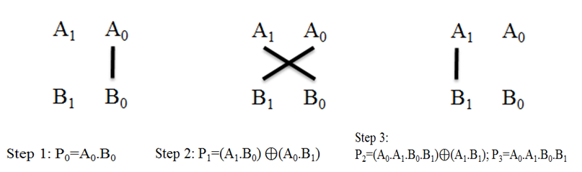
design of parity preserving reversible vedic multiplier
2×2 Vedic multiplier - Graphical representation

Slide 64
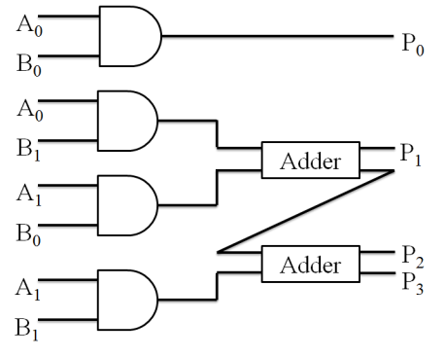
Hardware architecture of 2-bit Vedic multiplier

Slide 65
Approaches
Approach-1: All the functional units (AND and Adder) are constructed using only KMD gates
Approach-2: Combination of KMD gates (for Adder) and Fredkin (for AND logic) are used for construction.

Slide 66
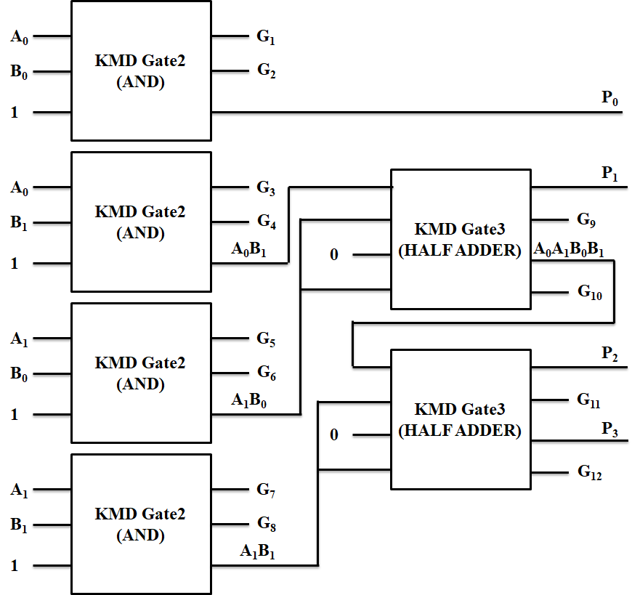
Approach 1
The KMD Gates architecture

Slide 67
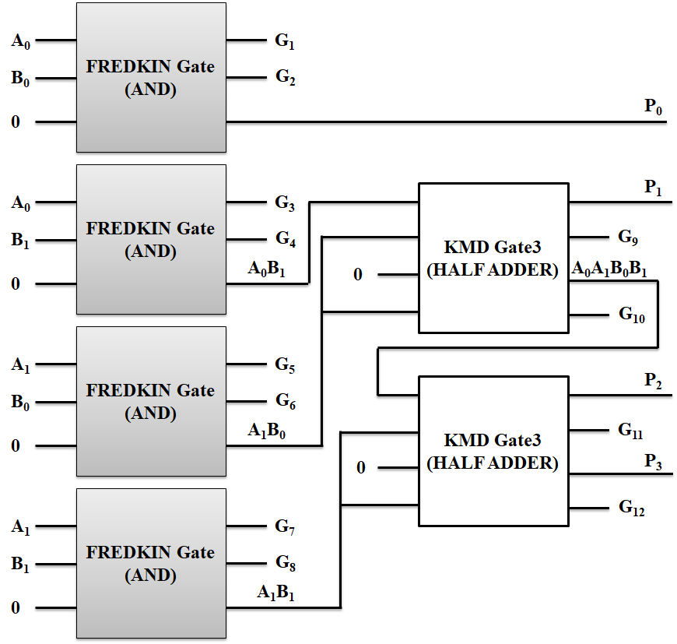
Approach 2
KMD and Fredkin Gates architecture

Slide 68
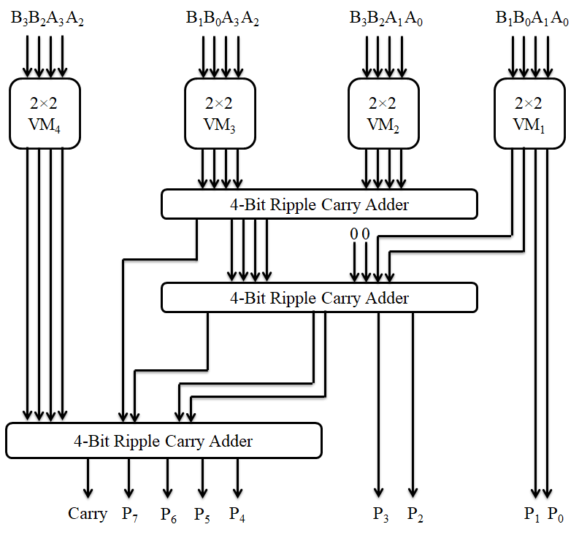
4×4 Vedic multiplier

Slide 69
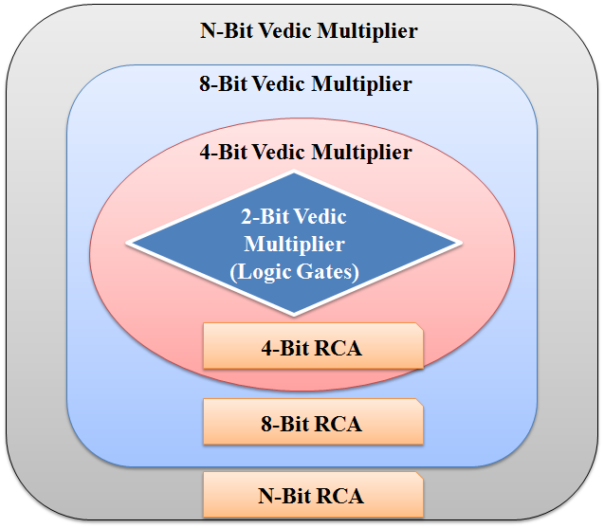
Generalized construction of n-bit Vedic Multiplier

Slide 70
4×4 reversible Vedic multiplier using QCA

Slide 71
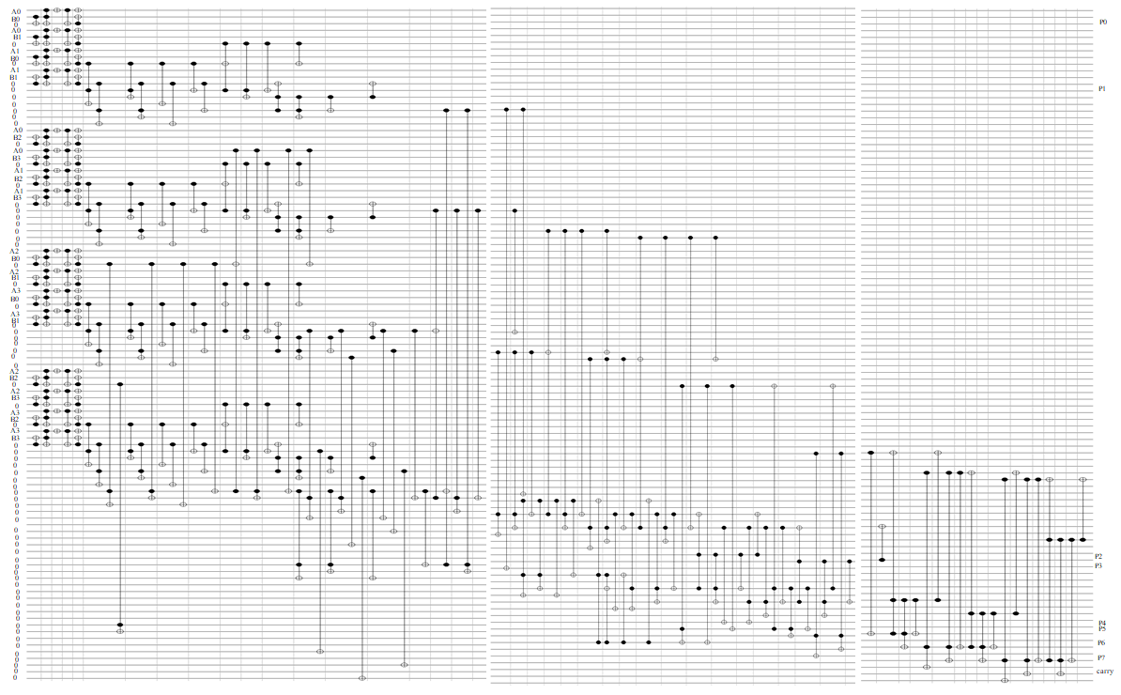
Quantum Circuit

Slide 72
Performance measure of Vedic Multiplier
Gate | QC | GO | CI | NoG | Total Cost (QC + GO + CI + NoG) | Logical Calculations
AND logic (KMD) | 10 | 2 | 1 | 1 | 14 | 2α+4β+3γ
AND logic (Fredkin) | 5 | 2 | 1 | 1 | 9 | 2α+4β+1γ
Half Adder | 9 | 2 | 1 | 1 | 13 | 5α+2β+1γ
Full Adder | 12 | 3 | 2 | 1 | 18 | 6α+5β+2γ
4-bit Adder | 48 | 12 | 8 | 4 | 112 | 24α+20β+8γ
2-bit Parity preserving Reversible Vedic Multiplier ( four AND + two Half Adder)
Approach - 1 | 58 | 12 | 6 | 6 | 82 | 18α+20β+14γ
Approach - 2 | 38 | 12 | 6 | 6 | 62 | 18α+20β+6γ
4-bit Parity preserving Reversible Vedic Multiplier (four 2-bit VM + three 4bit RCA)
Approach - 1 | 376 | 84 | 48 | 36 | 544 | 144α+140β+80γ
Approach - 2 | 264 | 84 | 48 | 36 | 432 | 144α+140β+48γ

Slide 73
Performance comparison
Cost Parameter | Vedic Multiplier (Normal) |  |  | Vedic Multiplier using only Parity Preserving |  |  |  | Proposed Vedic Multiplier
 | [59] | [55] | [64] | Fredkin and Toffoli | NFT | RUG | UPPG | Approach-1 | Approach-2
Quantum Cost | 164 | 162 | 128 | 424 | 432 | 960 | 480 | 376 | 264
Garbage Output | 43 | 62 | 40 | 160 | 64 | 64 | 112 | 84 | 84
Constant Input | 33 | 29 | 31 | 48 | 16 | 48 | 48 | 48 | 48
Number of gates | 33 | 37 | 31 | 60 | 48 | 36 | 48 | 36 | 36
Total cost | 273 | 290 | 230 | 692 | 560 | 1108 | 688 | 544 | 432
Logical Calculations | - | - | - | 112α+48γ | 144α+96β+144γ | 48α+144β+288γ | 144α+144β+220γ | 144α+140β+80γ | 144α+140β+48γ
Area (µm²) | - | - | - | - | - | - | - | 3.7 | 3.7

Slide 74
Percentage of improvement
Performance Cost | Improvement w.r.t.
 | Fredkin and Toffoli |  | NFT |  | RUG |  | UPPG
 | Approach-1 | Approach-2 | Approach-1 | Approach-2 | Approach-1 | Approach-2 | Approach-1 | Approach-2
Quantum Cost | 11.32% | 37.73% | 12.96% | 38.89% | 60.83% | 72.5% | 21.7% | 45%
Garbage Output | 47.5% |  | No |  | No |  | 25%
Number of gates | 40% |  | 25% |  | 0% |  | 25%
Total cost | 21.38% | 37.57% | 2.85% | 22.85% | 50.90% | 61% | 20.93% | 37.21%

Slide 75
Overall Performance
ARTHMETIC AND LOGIC UNIT (ALU)
Performance Cost | ALU using |  |  |  |  |  | Proposed ALU Architecture
 | RM Gate [35] |  |  | RUG Gate [36] |  |  | Approach-1 (KMD Gates) | Approach-2 (KMD, Fredkin and Toffoli Gates)
 | Arithmetic Unit | Logical Unit | Total | Arithmetic Unit | Logical Unit | Total
Quantum Cost | 140 | 140 | 320 | 67 | 94 | 197 | 118 | 99
Constant Inputs | 2 | 2 | 10 | 0 | 1 | 6 | 7 | 8
Garbage Outputs | 6 | 7 | 15 | 3 | 6 | 11 | 21 | 22
No. of Gates Used | 4 | 4 | 14 | 3 | 4 | 14 | 11 | 11
Logical Calculations | 2α+8β+3γ | α+9β+4γ | 8α+20β+9γ | 3α+β | α+6β+6γ | 9α+12β+11γ | 12α+14β+6γ | 12α+14β+6γ
Parameter | Improvement w.r.t. RM [35] |  | Improvement w.r.t. RUG [36]
 | Approach-1 | Approach-2 | Approach-1 | Approach-2
Quantum Cost | 63% | 69% | 40% | 49%
Constant Inputs | 30% | 20% | No | No
No. of gates used | 21% | 21% | 21% | 21%

Slide 76
Overall Performance
FLOATING POINT DIVISION UNIT
Performance Cost | Existing [50] |  | Existing [51] |  | Proposed
 | Restoring | Non-Restoring | Conventional Division Array | High Speed Division Array
No. of Gates | 18n+23 | 18n+21 | (3(n+2)²+2n)/4 | (n+2)(3n+11)/2 | 12n+4
Garbage outputs | 12n+18 | 12n+16 | (n+2)²/2 | (n+2)(3n+22)/4 | 20n+13
Quantum Cost | 75n+60 | 75n+53 | (4(n+2)²+n)/2 | (n+2)(7n+27)/2 | 68n+44
Constant Input | 11n+14 | 11n+12 | ((n+1)²+1)/2 | (n+2)(3n+14)/4 | 13n+6
Total Cost (QC + GO + CI + NoG) | 116n+115 | 116n+102 | - | - | 113n+67
VEDIC MULTIPLIER
Performance Cost | Improvement w.r.t.
 | Fredkin and Toffoli |  | NFT |  | RUG |  | UPPG
 | Approach-1 | Approach-2 | Approach-1 | Approach-2 | Approach-1 | Approach-2 | Approach-1 | Approach-2
Quantum Cost | 11.32% | 37.73% | 12.96% | 38.89% | 60.83% | 72.5% | 21.7% | 45%
Garbage Output | 47.5% |  | No |  | No |  | 25%
Number of Gates | 40% |  | 25% |  | 0% |  | 25%
Total cost | 21.38% | 37.57% | 2.85% | 22.85% | 50.90% | 61% | 20.93% | 37.21%

Slide 77
Contributions
Gates:
New Reversible Gates names KMD Gates of four numbers are proposed. It has Reversibility, Universality and Parity Preservation
KMD Gates are having reduced Average Quantum Cost
ALU:
18 Distinct Arithmetic and Logic Operations
Integrated ALU, rather than separate unit
Division:
Performance Costs are Linear Relationship with ‘n’
Multiplier:
Parity Preservation Unit with reduced Performance Cost

Slide 78
Conclusions
Reversible KMD gates with size of 3×3, 4×4 and 5×5 are proposed
13-standard Boolean functions - 1.76 gates (Avg.)
ALU – Integrated Arithmetic and Logical Modules
18 distinct ALU operations (10 arithmetic and 8 logical )
Improved quantum cost up to 69% and number of gates up to 21%
FP Division – IEEE754; non-restoring
Improvement in Quantum Cost at least by 9.35-9.85%, in Delay by 29.63% and in Number of Gates 8.06-33.54%
Vedic multiplier – Urdhwa Triyakbhyam
Improved performance in quantum cost of 14-72%, garbage output 57-80%, and constant input 78-87%.
Functional simulations – Quantum Cellular Automata;
Quantum Circuits – RCViewer+

Slide 79
References
Anantha Lakshmi, AV & Gnanou Florence Sudha 2017, ‘Design of a reversible floating-point square root using modified non-restoring algorithm’, Microprocessors and Microsystems, vol. 50, pp. 39–53.
Antoine Be´rut, Artak Arakelyan, Artyom Petrosyan, Sergio Ciliberto, Raoul Dillenschneider & Eric Lutz 2012, ‘Experimental verification of Landauer’s principle linking information and thermodynamics’, Macmillan Publishers Limited, vol. 483, pp. 187-190.
Arabani SR, Reshadinezhad MR & Haghparast M 2018, ‘Design of a parity preserving reversible full adder/subtractor circuit’, International Journal of Computational Intelligence Studies, vol. 7, no. 1, pp. 19-32.
Ashvin Chudasama, Trailokya Nath Sasamal & Jyoti Yadav 2018, ‘An efficient design of Vedic multiplier using ripple carry adder in Quantum-dot Cellular Automata’, Computers and Electrical Engineering, vol. 65, pp. 527-542.
Bandan Bhoi, Neeraj Kumar Misra & Manoranjan Pradhan 2017, ‘Design and evaluation of an efficient parity-preserving reversible QCA gate with online testability’, Cogent Engineering, vol.4, pp. 1-18.
Bennett, CH 1973, ‘Logical Reversibility of computation’, IBM Journal of Research and Development, vol. 17, pp.525 – 532.
Bibhash Sen, Manojit Dutta, Mrinal Goswami & Biplab Sikdar, K 2014, ‘Modular Design of stable reversible ALU by QCA multiplexer with increase in programmability’, Microelectronics Journal, vol. 45, no. 11, pp. 1522–1532.
Faraz Dastan & Majid Haghparast 2011, ‘A novel nanometric fault tolerant reversible divider’, International Journal of the Physical Sciences, vol. 6, no.24, pp. 5671-5681.
Fredkin, E & Tommaso Toffoli 1980, ‘Conservative Logic’, MIT Laboratory for Computer Science, International Journal of Theoretical Physics vol. 21, pp. 219–253.
Gowthami, P & Satyanarayana, RVS 2018, ‘Performance Evaluation of Reversible Vedic Multiplier’, ARPN Journal of Engineering and Applied Sciences, vol. 13, no. 3, pp. 1002-1008.
Jamal, L & Babu, HMH 2013, ‘Efficient approaches to design a reversible floating point divider’, Proceedings of the IEEE International Midwest Symposium on Circuits and Systems, vol. 13, pp. 3004–3007.
Landauer, R 1961, ‘Irreversibility and heat generation in the computing process’, IBM Journal of Research and Development, vol. 5, no. 3, pp. 183-191.
Rakshith, TR & Saligram, R 2013, ‘Design of High Speed Low Power Multiplier using Reversible logic: a Vedic Mathematical Approach’, International Conference on Circuits, Power and Computing Technologies (ICCPCT-2013), pp. 775-781.
Saligram, R & Rakshith TR 2013, ‘Optimized Reversible Vedic Multipliers for High Speed Low Power Operations’, IEEE Conference on Information and Communication Technologies (ICT 2013), pp. 809-814.
Trailokya Nath Sasamala, Ashutosh Kumar Singh & Anand Mohanaa 2016, ‘Efficient design of reversible ALU in quantum-dot cellular automata’, Optik Journal, vol. 127, pp. 6172–6182.

Slide 80
Publications
Annexure – I / Revised Journal List 2019
Kamaraj, A & Marichamy, P 2018, ‘Design of Fault-Tolerant Reversible Floating Point Division’, Informacije MIDEM – Journal of Microelectronics, Electronic Components and Materials, vol. 48, no. 3, pp. 161–171. (Impact Factor = 0.476) (S. No. 4902 – Anna University revised Journal list).
Kamaraj, A & Marichamy, P 2019, ‘Design of integrated reversible fault-tolerant arithmetic and logic unit’, Microprocessors and Microsystems, vol. 69, pp. 16–23. (Impact Factor = 1.049) (S. No. 8390 – Anna University revised Journal list).
Kamaraj, A & Marichamy, P 2019, “Design of fault-tolerant reversible Vedic multiplier in quantum cellular automata”, Journal of the National Science Foundation of Sri Lanka, vol. 47(4), pp.371-382. (Impact factor = .0419) (S. No. 7605 – Anna University revised Journal list).
Annexure – II
A.Kamaraj, Dr.Marichamy, Published a Paper titled, Design and Implementation of Adders Using Novel Reversible Gates in Quantum Cellular Automata, in Advances in Natural and Applied Sciences, Vol. 9, Issue - 17, Page No: 50-57, March 2016, (Impact Factor: 0.1190).
A.Kamaraj, Dr.Marichamy Published a Paper titled, Design of Reversible Logic Based Area Efficient Multilayer Architecture Router in QCA, in International Journal of Applied Engineering Research, Vol. 10, Issue - 1, Page No: 140-144, October 2015, (Impact Factor: 0.1490).
A.Kamaraj, Dr.Maricham Published a Paper titled, Design of Reversible Logic based Single Precision Floating Point Multiplier for FFT, in International Journal of Applied Engineering Research, Vol. 10, Issue - 1, Page No: 157-162, October 2015, (Impact Factor: 0.1490).
A.Kamaraj, Dr.Marichamy, C.Kalyana Sundaram, Dr.J.Senthil Kumar Published a Paper titled, Design And Implementation of A Reversible Logic Based 8-Bit Arithmetic and Logic Unit, in International Journal of Computers and Applications, Vol. 2, Issue - 1, Page No: 49-55, September 2014, (Impact Factor: 0.1160).

Slide 81
Comments from Examiners
Indian Examiner

Slide 82
Comments from Examiners
S. No. | Comments of the Examiner | Actions taken by the Author
 | The one most important suggestion is the definition for all the adopted symbols which are requires clear. For example, the “alpha”, “beta”, and “gama” expressed in Table 3.5 at pp.86. Please check up through the Thesis. | In the Chapter 1, Sub-Section 1.7.4, pp.13 given with the definition of Logical Calculations and explanations of “alpha”, “beta”, and “gama” using examples. Table 3.5, pp.86 is denoted with the meaning of α, β and γ. Also, these symbols are included in the ‘List of Symbols and Abbreviations’ in pp. xx
 | Several reports of performance analysis are expressed in Chapter 3 in which there are much of the comparison results are shown detail. However, it is suggested that those shown values can be expressed clearly with abstract discussion. For example, the Quantum Cost is “9” shown on Table 3.12 for KMD Gate3 the proposed design in pp.108, to explain with reasons for obtaining “9” is necessary. | The definition, explanation and examples are discussed in Chapter 1, Sub-Section 1.7.1, pp.11. As per the definitions, the Quantum Costs are calculated for the KMD Gates as shown in Annexure I. These Quantum Costs are used throughout the Thesis for performance calculations.
 | It is also another interesting issue to be addressed, what the algorithm definitely to define the “Logical Calculations” is shown in the last column of Table 3.1. | In the Chapter1, Sub-Section 1.7.4, pp.13 given with the definition of Logical Calculations, explanations and method to obtain with examples. Based on this concept, the Logical Calculations of Table 3.1, pp.77 is obtained. The same logical calculation definition is adopted throughout the Thesis.
 | There are several issues suggested discussed deeply, for example, the issue claimed in Table 4.8. “… the performance cost of … linearly increase…”. Please explain clear. | The Section 4.3, Table 4.8, pp.127 shows the performance cost of n-bit ALU. The n-bit ALU can be constructed by replicating the 1-bit ALU structure for n times. In this process there is no additional hardware is required. Thus the performance cost of the ALU is linearly increasing with number of bits (n). In other words number of bits and performance cost are directly proportional. There is no additional hardware overhead.
 | The reviewer suggests that the ways to set up the simulation environment are required explained briefly. Thus, it can make sense the trusties for the proposed ALU expressed in Chapter 4. | The Simulation Environment and its specifications are explained in Annexure II. The same environment is maintained for the simulation of KMD Gates, ALU, Floating Point Division and Vedic Multiplier in QCA.
 | Is there any reason or referred that “The proposed ALU performs 18 distinct Arithmetic and …” expressed in Chapter 4. That is, if the results of the performance will become degradation when the number of Arithmetic increased. | In general, the number of operations and performance cost are directly proportional. But the capability of the reversible gates will reduce the performance cost. The proposed KMD Gates are capable of producing all logical functions with reduced performance cost as shown in Section 3.3, Table 3.4, pp.85. The Number of Gates and Quantum Cost required for the construction of 13 standard Boolean expressions using Proposed KMD Gates and other reversible gates are shown in Table 3.6, pp.93 which proves that the minimum numbers of gates are required for the construction complex logical functions using KMD Gates. The Table 3.8, pp.96-97 shows the derivation of necessary logical functions using the KMD Gates for the construction of ALU, Division and Vedic Multiplier. Thus, in the proposed ALU the 18 distinct functions are obtained with reduced quantum cost, constant input and garbage output using KMD Gates.
 | All the acronym symbols of the context should be noted through all over the thesis. | The acronym and symbols used in the entire Thesis is checked and all of them were included the ‘List of Symbols and Abbreviations’ in pp. xviii.
 | Please give some words to express the operation of quantum circuit shown in Figure 5.9 and Figure 6.11? Moreover, the explanation to the methods for obtaining Quantum Cost expressed in pp.141 is requested. | The quantum circuit of the KMD Gates and its derivative functions are shown in Section 3.3, Figure 3.4 and Table 3.8 respectively. These quantum circuits are connected according to the hardware architecture of the ALU, Floating Point Division and Vedic Multiplier (Figure 4.2, Figure 5.2 and Figure 6.3) to obtain the quantum circuit of them as shown in Figure 4.7 (pp.119, Sub-Section 4.2), Figure 5.9 (pp.141, section 5.4) and Figure 6.11 (pp.160, section 6.3). The operations of the quantum circuits are as same as that of the corresponding hardware architectures. The inputs (Data inputs and Constant inputs) are applied to the input modules, they are processed in the data processing module and the outputs are forwarded to the output module. The quantum cost in pp.141 is obtained by summing up the quantum cost of the individual modules as shown in Table 5.3 (pp.142). The quantum cost of the individual modules of Division Unit is discussed in detail in Section 5.3.
 | Specifically, it interesting in providing 2 approaches discussed in Chapter 6. The results from the corresponding way seem natural. Please give the reasons for describing the two schemes when the defense rehearsal is held. | In order to reduce the quantum cost of the Vedic Multiplier without compromising in Parity preservation and functionality Approach 2 is adopted in Chapter 4 and Chapter 6. The Garbage output, Constant Input and Number of Gates are remains the same in both approaches as shown in Section 6.4, Table 6.2 (pp.162) and Table 6.3 (pp.163).

Slide 83
Thanks to …
Supervisor – Dr.P.Marichamy
Doctoral Committee Members
PSR – Management, Principal, HODs, Faculty and Staffs.
MSEC – Management, Principal, HODs, Faculty and Staffs.
Parents and Sisters
My Master (Guru)

